Slide 1
SWEREA Traceability App
Group 6
Mohannad Alahdab
Martin Arvedahl
Axel Ekdahl
Emina Hromic
Humberto Linero

Slide 2
Video

Slide 3
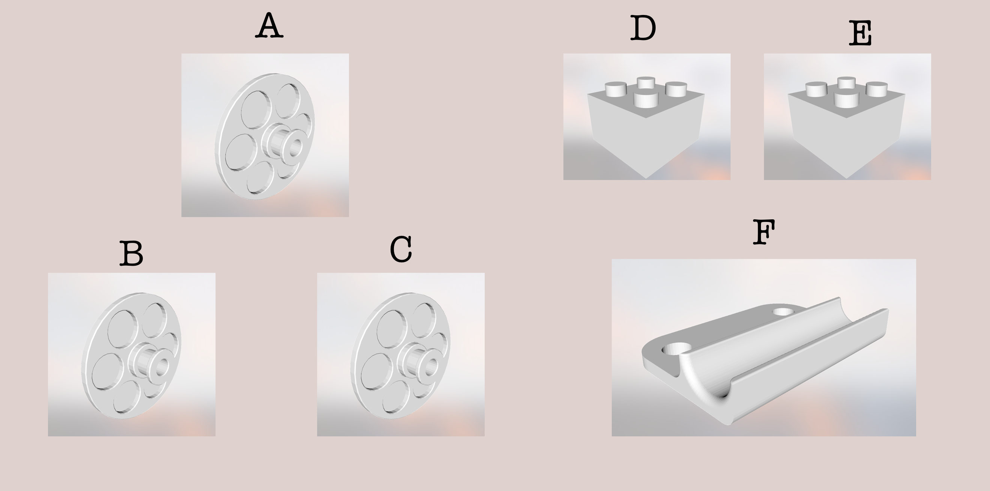
Magics ID | STL Filename
A, B , C | wheel.stl
D, E | block.stl
F | other.stl

Slide 4
SWEREA Traceability App
Mohannad Alahdab
Martin Arvedahl
Axel Ekdahl
Emina Hromic
Humberto Linero

